Slide 1

Quora Question Pairs
Kaggle Competition
Text Mining and Deep Learning: Project 1
Course Coordinator:
Anna Wróblewska
Group members:
Elie Saad
Heshan Fernando

Slide 2

Presentation Outline
Defining The Problem
Describing The Dataset
Data Preprocessing
TF-IDF
eXtreme Gradient Boost
Findings
Future Works

Slide 3

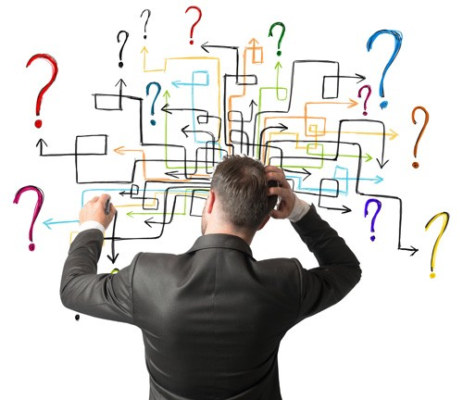
Defining The Problem
3,000 – 5,000 questions per day
125 – 208.3 questions per hour
2 – 3.5 questions per min
There is bound to be duplicate questions.
How to remove duplicates?

Slide 4
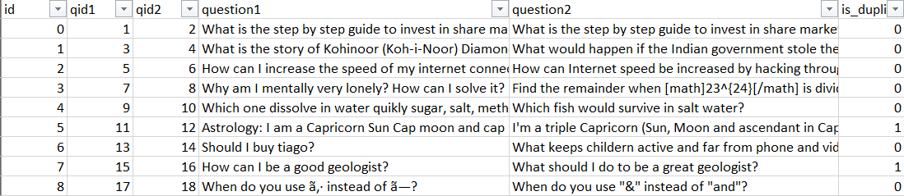
Describing The Dataset
404,289 rows of skewed data.
2 questions per row.
6 columns: id, qid1, qid2, question1, question2, is_duplicate

Slide 5
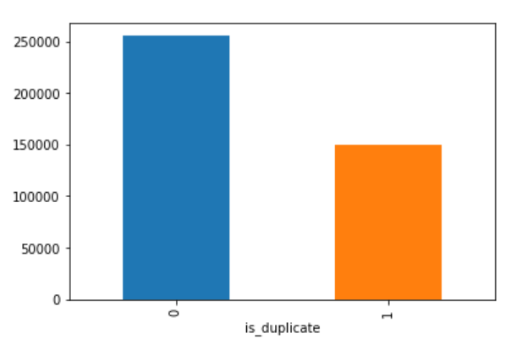
Describing The Dataset
149,263 (or 36.9%) duplicate questions.
255,027 (or 63.1%) non-duplicate questions.

Slide 6
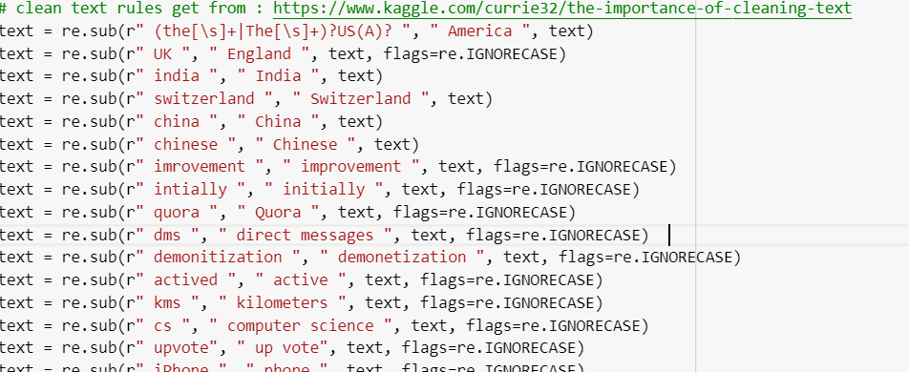
Data Preprocessing
Data Cleansing:
We followed the text cleansing methodology available in Kaggle.

Slide 7
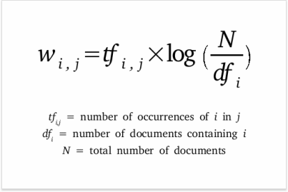
Text Frequency - Inverse Document Frequency (TF-IDF)

Slide 8
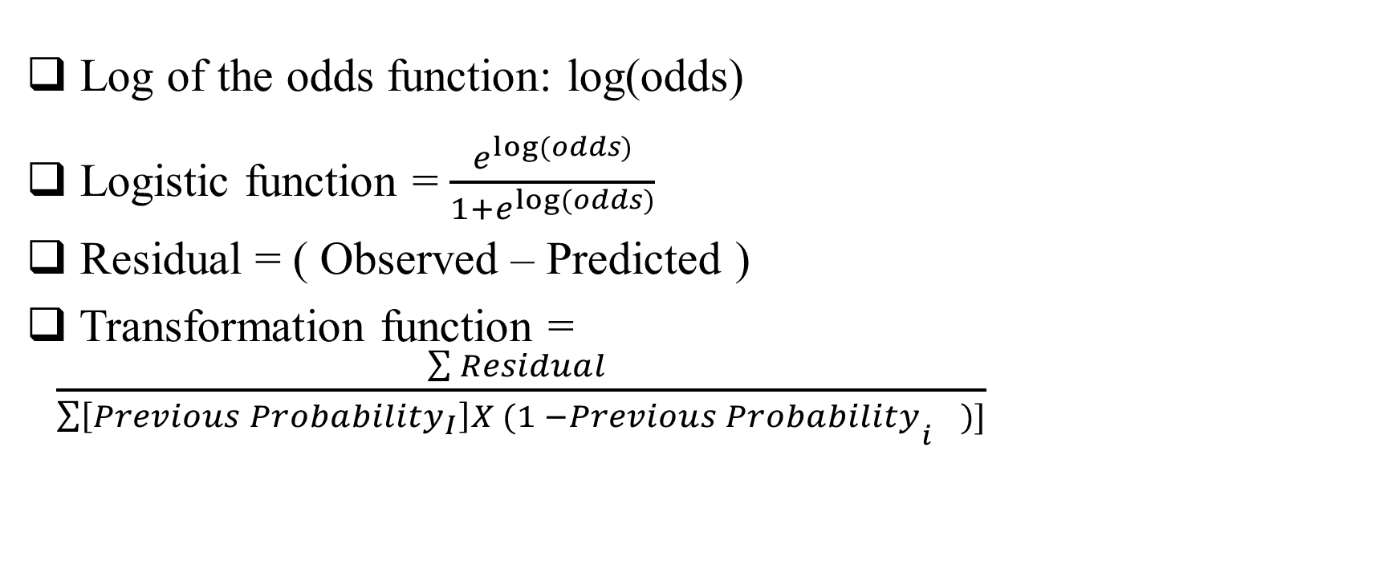
eXtreme Gradient Boost
Log of the odds function: log(odds)
Logistic function = $\frac{e^{log⁡(odds)}}{1+e^{log⁡(odds)}}$
Residual = ( Observed – Predicted )
Transformation function = $\frac{\sum{Residual} }{\sum{\left[{Previous Probability}_{I}\right]X (1 −{Previous Probability}_{i^{}})]}}$

Slide 9
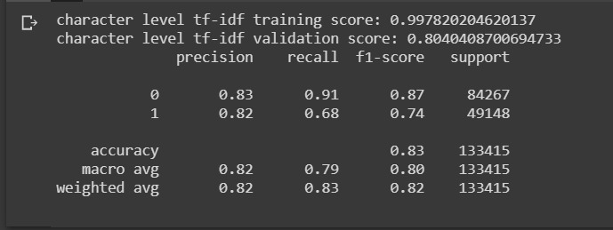
Findings
Training Accuracy:

Slide 10
Future Works
Balanced the dataset.
Replace TF-IDF with word2vec.
Replace XGBoost with LSTM RNN.

Slide 11
Any Questions?

Slide 12
